Slide 1




2026 Symposium for
Chief Staff Executives and
Chief Elected Officers
CEO Symposium Page 1
©2026 Tecker International, LLC • www.tecker.com

Slide 2
2026 CEO SYMPOSIUM
Copyright@2026 by Tecker International, LLC
- All Rights Reserved -
These materials were specially prepared for instructional use by Tecker International, LLC. No portion of these materials, in whole or in part, may be used in any fashion, or reproduced by any means, without the written permission of Tecker International, LLC.
For more information and valuable links to other sources of information and insight, please visit
www.tecker.com
Tecker International, LLC
301 Oxford Valley Road, Suite 1504 B, Yardley, PA 19064
215-493-8120
info@tecker.com
CEO Symposium Page 2
©2026 Tecker International, LLC • www.tecker.com

Slide 3
2026 CEO SYMPOSIUM FACULTY
Glenn Tecker, Chair & Co-CEO, Tecker International, LLC
Donna F. Dunn, CAE, Principal Consultant, Tecker International, LLC
Jim Meffert, Principal Consultant, Tecker International, LLC
Greg Fine, FASAE, CAE, Principal Consultant, Tecker International, LLC
Cheryl Williams, Senior Consultant, Tecker International, LLC
Dan Tecker, Senior Consultant, Tecker International, LLC
2026 SYMPOSIUM PROGRAM DEVELOPMENT TEAM
Glenn Tecker, Chairman & Co-CEO, Tecker International, LLC
Donna Dunn, CAE, Principal Consultant, Tecker International, LLC
Jim Meffert, Principal Consultant, Tecker International, LLC
Greg Fine, FASAE, CAE, Principal Consultant, Tecker International, LLC
Michael Anderson, Principal Consultant, Tecker International, LLC FASAE, FAUSAE
Trace Haythorn, Ph.D., PCC, Senior Consultant, Tecker International, LLC
Jennifer Kelly, Senior Consultant, Tecker International, LLC
Dan Tecker, Senior Consultant, Tecker International, LLC
Cheryl Williams, Senior Consultant, Tecker International, LLC
CEO Symposium Page 3
©2026 Tecker International, LLC • www.tecker.com

Slide 4


Download the Workbook
https://ceosym.tecker.com
Download digital versions of the workbook (PowerPoint and PDF)
Access supplemental materials referenced during the program
questions@tecker.com
CEO Symposium Page 4
©2026 Tecker International, LLC • www.tecker.com

Slide 5
CEO Symposium Overview
Discussion Thread 1
Special nature of associations
and implications for how they are best led
Discussion Thread 2
Chief Staff Executive and Chief Elected Officer
relationships that sustain partnership and board success
Discussion Thread 3
Roles, relationships, and responsibilities
related to guiding the governing board
CEO Symposium Page 5
©2026 Tecker International, LLC • www.tecker.com

Slide 6

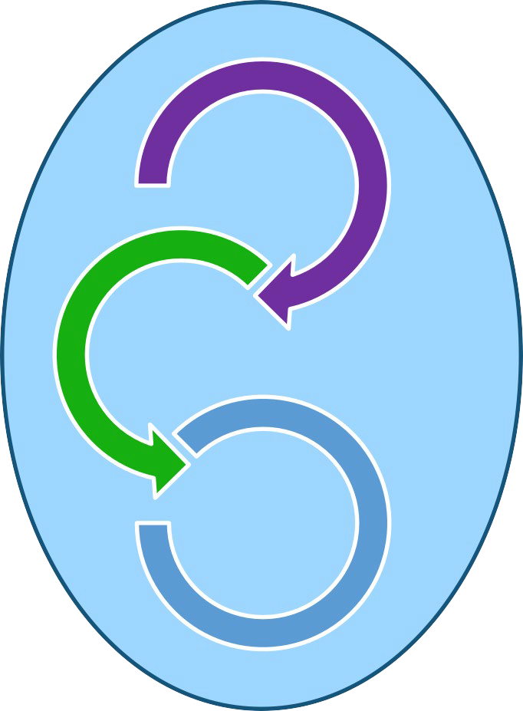
Discussion Thread 1 - Special Nature of Associations
Structure
Unique nature of associations
Characteristics of successful associations
Association life-cycles
Essential components of governance
Process
Outcomes
Culture
CEO Symposium Page 6
©2026 Tecker International, LLC • www.tecker.com

Slide 7
Your Model Of Leadership Behavior?
Where does your “mental model” for Chief Elected Officer come from? (such as experience with another association, corporate, community organization, service
organization, academic institution, etc.)
Where does your “mental model” for Chief Staff Executive come from?
CEO Symposium Page 7
©2026 Tecker International, LLC • www.tecker.com

Slide 8
Your Model Of Leadership Behavior?
Please list the major differences between the source(s) of your “mental models” and your current association:
(for example: purpose, population served, structure, process, culture, etc.)
________________________________________________________
What are the implications of those differences for your leadership in this association ?
CEO Symposium Page 8
©2026 Tecker International, LLC • www.tecker.com

Slide 9

An Association
A group of people who voluntarily come together to solve common problems, meet common needs, and accomplish common goals.
CEO Symposium Page 9
©2026 Tecker International, LLC • www.tecker.com

Slide 10

Why People Behave the Way They Do
What is perceived is
Perceptions are based on available information
In the absence of information, we assume
Behavior, no matter how crazy,
has a logical basis
CEO Symposium Page 10
©2026 Tecker International, LLC • www.tecker.com

Slide 11

Draw a picture of your association today if it were depicted as an automobile.
What is the make, model & year, and any options. Be prepared to explain what organizational attributes are represented by certain details of the picture.
CEO Symposium Page 11
©2026 Tecker International, LLC • www.tecker.com
1

Slide 12
Your association today depicted as an automobile:
Make:
Model & Year : Options:
Organizational Attributes:
CEO Symposium Page 12
©2026 Tecker International, LLC • www.tecker.com
14

Slide 13
What we are seeing in successful associations
Move to Governance Structures based on a capability-based Board with a rigorous selection of leadership candidates and that are volunteer centric
Focus on purpose and service to members
Boards focus on strategic big issue, big picture conversations and establishing appropriate measures of impact
More ad hoc short term work groups with tangible outcomes
Continuous program portfolio review to match evolving member needs and matching commitments to capacity
Re-investing in face-to-face meetings and using virtual for in-between conversations
Install a process and policy for effectively managing conflict
CEO Symposium Page 13
©2026 Tecker International, LLC • www.tecker.com

Slide 14



Planning Strategically
Thinking Strategically
Thinking Strategically is the foundation of all activities and actions.
An Ongoing Process for Continuous Improvement to Deliver Impact
Acting Strategically
Acting strategically putts the plan into motion and ensuring the organization follows through with its commitments.
This process translates strategic thinking into a clear, prioritized, actionable plan.
CEO Symposium Page 14
©2026 Tecker International, LLC • www.tecker.com

Slide 15
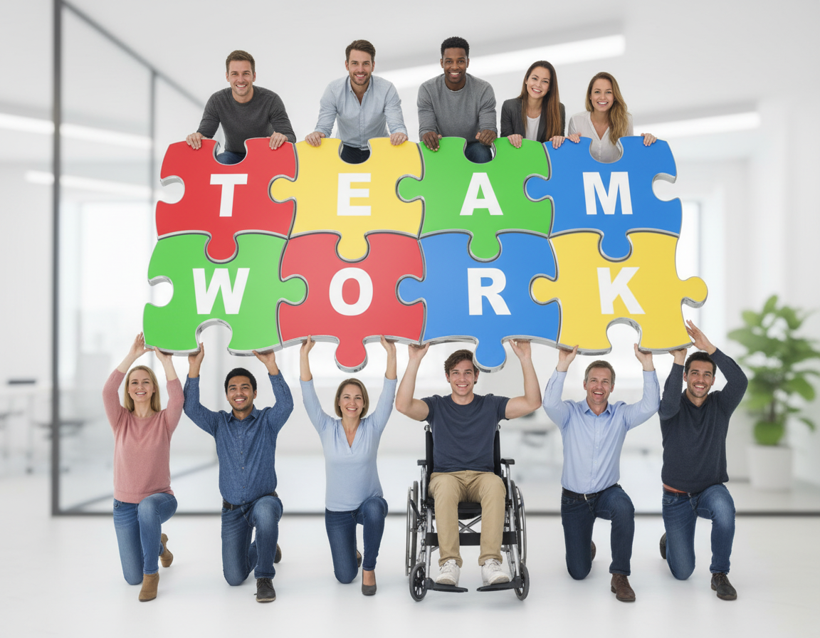
The Strategic Board Agenda
Discussion of Mega Issues
Review and Adjustment of Strategy
Policy: Public & Operational
Routine Board Business
CEO Symposium Page 15
©2026 Tecker International, LLC • www.tecker.com

Slide 16
Unique nature of associations
What makes associations unique is that the same populations are:
  the owners,
  the customers and
  the workforce of the organization.
CEO Symposium Page 16
©2026 Tecker International, LLC • www.tecker.com

Slide 17
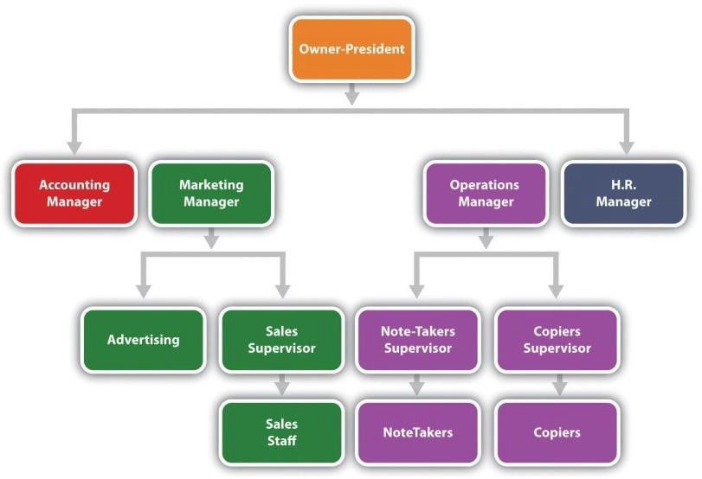
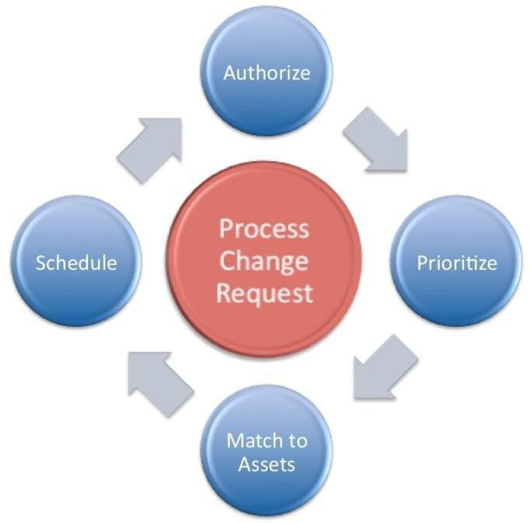
Associations As A Collaborative Network Rather Than A Traditional Hierarchy
In Associations most significant decisions are made by a process rather than by a person or position…
CEO Symposium Page 17
©2026 Tecker International, LLC • www.tecker.com

Slide 18
Purpose and Values
Leadership partnership, effectively leading the organization into the future
Exercise
What’s our core purpose, what are our core values, what are we uniquely positioned to deliver
CEO Symposium Page 18
©2026 Tecker International, LLC • www.tecker.com

Slide 19
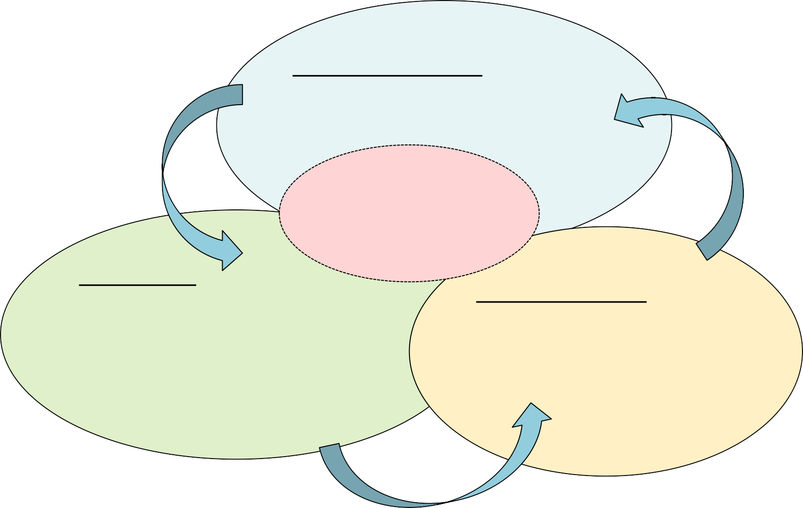
Associations are unique – How we deliver value
Commitment:
Consistent and organized focus on important things of high value that require coherent effort over time.
TRUST
Our “Brand” Member’s Actual Experience
TRUST
Content:
Advocacy- effective clout that influences the beliefs and behaviors of others that affect things that are significant to me; Knowledge – insight that enables me to be successful at things that really matter to me.
Community:
Enjoyable shared experience that makes me feel better about myself and my place in the world.
TRUST
CEO Symposium Page 19
©2026 Tecker International, LLC • www.tecker.com

Slide 20
Associations are unique – How we deliver value
Commitment:
TRUST
Our “Brand”
TRUST
Content:
Community:
TRUST
CEO Symposium Page 20
©2026 Tecker International, LLC • www.tecker.com

Slide 21
Revitalization
Obscurity
Dissolution
Concept
Regression
Startup
Life Cycle of an
Association
Adapted from work by
J.J. Cribbins
Complacency
Professionalization
Fulfillment
Formalization
CEO Symposium Page 21
©2026 Tecker International, LLC • www.tecker.com

Slide 22
The Development Phase
Concept: A group of people see an advantage to voluntarily coming together to start an association.
Startup: The founders are still in charge as the organization struggles to survive. Every job requires more work than the founders can do.
Professionalization: The organization grows steadily, but suffers awkwardness in its dealings with outsiders and with internal coordination. Entrepreneurial skills are gradually replaced by more professional management techniques and skills.
CEO Symposium Page 22
©2026 Tecker International, LLC • www.tecker.com

Slide 23
The Mature Phase
Formalization: Accepted management practices are implemented, including formalized personnel practices. The beginning of bureaucracy and internal politics are evident.
Fulfillment: The organization is mastering its environment and serving the needs of its members. Management is peaking and preparing to expand by adding new areas of services and/or functions.
CEO Symposium Page 23
©2026 Tecker International, LLC • www.tecker.com

Slide 24
The Declining Phase
Complacency: The excitement of the organization has diminished. The membership will not support innovation. A complacent atmosphere lacking any sense of urgency or zeal prevails.
Regression: The organization is losing its ability to cope with its environment and serve the real needs of its members. Managers and leaders bicker and internal control is lacking. All of a sudden things seem to come apart and few people seem to care.
Revitalization / Obscurity / Dissolution?
CEO Symposium Page 24
©2026 Tecker International, LLC • www.tecker.com

Slide 25
Revitalization
Obscurity
Dissolution
Concept
Given where your organization is on the life cycle, what does your leadership partnership need to focus on?
Regression
Startup
Life Cycle of an
Association
Complacency
Professionalization
Adapted from work by J.J. Cribbins
Fulfillment
Formalization
CEO Symposium Page 25
©2026 Tecker International, LLC • www.tecker.com

Slide 26
Model of Association Infrastructure
Culture
Key Processes
Research, Data & Analytics
Strategy
Policy
Resource Allocation
Key Structures
Membership
Governance
Program
Workforce
Financial
6. Technology
CEO Symposium Page 26
©2026 Tecker International, LLC • www.tecker.com

Slide 27
Organizing and Aligning
An organization’s structure results in better performance only if it improves the organization’s ability to make and execute key decisions better and faster.
If an organization can sync its structure with its strategy, then the structure will work better, and performance will improve.
Adapted from, “The Decision-Driven Organization,” HBR
CEO Symposium Page 27
©2026 Tecker International, LLC • www.tecker.com

Slide 28
What Needs Attention?
1= Strongly Disagree 2=Disagree 3=Agree 4=Strongly Agree
Our structure helps-rather than hinders-the decisions most critical to our success.
Individuals understand their roles and accountability in our most critical decisions.
Our processes are designed to produce effective, timely decisions and action.
The people in critical decision roles have the information they need when and how they need it.
Our evaluation processes focus board and staff on the progress toward our goals.
CEO Symposium Page 28
©2026 Tecker International, LLC • www.tecker.com

Slide 29
What Needs Attention?
1= Strongly Disagree 2=Disagree 3=Agree 4=Strongly Agree
People understand their priorities clearly enough to be able to make and execute the decisions they face?
We make decisions in a style that is effective (for example, that appropriately balances inclusiveness with momentum).
We put the right people in the right roles, so the organization has the best possible outcome.
Our leaders at all levels consistently demonstrate effective decision behaviors.
Our leadership partnership ensures that adaptations to move forward and the effectiveness of our processes guide the actual work of the association.
CEO Symposium Page 29
©2026 Tecker International, LLC • www.tecker.com

Slide 30
HISTORICAL FORCES
EXTERNAL FORCES
Trends
Economy Demographics Government Perceptions
INTERNAL FORCES
Staff Volunteers Process Procedures Customer Expectations
Politics Norms Behaviors Customs
Culture: a set of shared beliefs, values, attitudes, behaviors and practices that characterize an organization.
LEADERSHIP
Values
Beliefs Behaviors
ORGANIZATIONAL CULTURE
Informal Structures and Processes Performance/Outcomes
Trust Productivity
Allocation of Resources
CEO Symposium Page 30
©2026 Tecker International, LLC • www.tecker.com

Slide 31

Culture Change
Culture change follows behavior change
In associations change the process and you can change the behavior
Change behaviors and mind-set will follow
CEO Symposium Page 31
©2026 Tecker International, LLC • www.tecker.com

Slide 32

From the areas you may have identified as inviting attention:
What does the leadership partnership need to do to ensure that the two or three top priorities are addressed?
CEO Symposium Page 32
©2026 Tecker International, LLC • www.tecker.com

Slide 33
Discussion Thread 2 – Chief Staff / Chief Elected Partnership
Building the leadership partnership
Board roles and responsibilities
Trust as an essential element in leadership
Establishing norms
Structure
Process
Outcomes
Culture
CEO Symposium Page 33
©2026 Tecker International, LLC • www.tecker.com

Slide 34
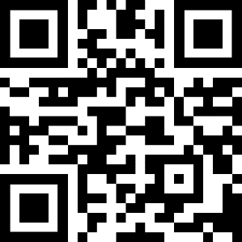
Understanding One Another’s Thinking & Working Style Preferences
Four key dimensions of leader work and related preferences in associations:
Communicating/problem-solving (E-I)
Planning (S-N)
Decision-making and conflict resolution (T-F)
Day-to-day working relationship (P-J)
Scan the QR code or visit jung.tecker.com
MY MBTI TYPE
CEO Symposium Page 34
©2026 Tecker International, LLC • www.tecker.com

Slide 35
Extrovert & Introvert Preferences
E&I: The Leadership Dimension of Communicating and Problem Solving
The E and I preferences indicate where a person gets their energy and zest for life. An Extrovert is stimulated by the outside environment — by people, places, and things. Introverts, on the other hand, are simulated from within — from their own inner world of thoughts and reflections. Extroverts are energized by what is going on around them (cocktail parties prove this) and do their best work externally by taking action. They prefer to communicate openly and freely. Introverts, are energized by their own personal experiences (not other’s experiences) and inner resources, and they do their best work internally by providing reflection and deep thought before taking action. They prefer not to communicate openly and freely until they know and trust someone. (Ever try to stimulate group interaction with a group of Introverts who do not know one another?).
Extroverts tend to focus on broad implications and Introverts focus on more single subjects in-depth — both are required for effective problem solving and can be effectively utilized if the partners understand their differences.
Partners with the same preference may lack either the breadth or in-depth perspective in their analysis, which presents a different challenge. How do they achieve balance in their problem solving?
Extroverts tend to think and problem solve out loud. You know that they are problem solving because you can see their lips moving and hear them thinking. The analogy is that their computer is connected on-line to their printer. Extroverts often say, “Just let me talk long enough and I will figure out the answer.”
Introverts usually problem solve differently. They require a short period of quiet reflection time to think about and reflect on the problem before they can discuss it. Their analogy is that they need to put their information in batch-storage, review it and then release it to the printer. Introverts typically say, if I can just get some quiet time to hear myself think, I can figure out the answer.
A significant challenge occurs when you mix E’s and I’s together in problem solving. E’s immediately start talking out loud and the I’s cannot hear themselves think (just like radar or communication jamming). The result of this situation is that the I’s will not interact in the problem solving at all.
Two E’s (is anyone listening?) or two I’s (is anyone talking?) also have their challenges when communicating and problem solving.
Adaptation by Bud Crouch
based upon The Myers Briggs Type Indicator®
CEO Symposium Page 35
©2026 Tecker International, LLC • www.tecker.com

Slide 36
Sensing & iNtuiting Preferences
S&N: The Leadership Dimension of Planning
The Sensing and iNtuiting functions are ways that we prefer to perceive and take in information. The Sensing function takes in information by way of the five senses and likes to look at specific parts and pieces of that information, deal with known facts and live in the present enjoying what exists.
The iNtuiting function also takes in information via the five senses, but then adds a sixth sense — a gut hunch or intuitive feeling. Most N’s will state, I make my worst decisions when I go against my intuitive hunch. N’s are very conceptual and prefer to look at overall patterns and relationships. They like to deal with broad concepts or possibilities, and they plan in the future. They enjoy anticipating what might be.
As a result of the broad preferences, S’s and N’s tend to approach planning differently. N’s prefer the broad, overall conceptual look, like to work with possibilities in the future and are comfortable with visioning processes. N’s like to define where the organization is going and the possible attributes, conditions, outcomes that it may seek to obtain.
S’s, on the other hand, prefer step-by-step pragmatic planning that is based upon what can feasibly be accomplished today. They are most comfortable in developing strategies, steps and action plans to achieve certain goals. They prefer to define how the organization is going to achieve its goals.
If N’s conceived of putting man on the moon, the S’s devised the systems and hardware to make it happen.
Obviously, a good plan requires both perspectives — long range conceptual goals (where) and pragmatic strategies and actions plans (how). It is important to understand which strengths and preferences each partner brings to the planning process.
For partners of the same preference, the challenge is that they may not focus on one of the two critical planning components — either the where or the how.
Adaptation by Bud Crouch
based upon The Myers Briggs Type Indicator®
CEO Symposium Page 36
©2026 Tecker International, LLC • www.tecker.com

Slide 37
Thinking & Feeling Preferences
T&F: The Leadership Dimension of Decision-Making and Conflict Resolution
The Thinking and Feeling functions are ways that we prefer to decide and evaluate. The Thinking preference decides on the basis of logic and objective considerations (in their head, not in their heart). T’s prefer to decide things on an impersonal basis. They keep their personal feelings at a distance from the issues that are being decided. They tend not to let their emotions become involved in the decision- making process, and they highly value the notion, reasonableness and competence in any decision-making. It is not that T’s do not have feelings — just that they do not get their feelings involved in the decision-making process.
Feeling types also make decisions objectively in their head, but they then add a subjective component of deciding in their hearts based on issues of personal and subjective values.
F’s tend to decide things on the basis of what they like or don’t like, their values, and the impact of the proposed decision on people (they have strong values on how people should be properly and fairly treated). As a result, F’s tend to literally place themselves inside the situations. They tend to put themselves in other peoples shoes and are sensitive to how this may feel. Now, their feelings become involved in the decision-making process.
Because of these different preferences, T’s and F’s approach and handle conflict differently. T’s like to get disagreements out into the open. T’s tend to enjoy a good argument (discussion), and to argue points based on what they perceive as reason without involving much emotion. As a result, they can walk away from a good argument or confrontation and think no more about it.
F’s generally do not like conflict and tend to avoid it. Because they often get their personal feelings involved, conflict has more of an emotional impact on them. They often worry about how they could have handled the situation differently (better). They tend to think and mull over what went on during the process.
The one area where F’s will enter into conflict is when they think that people have been mistreated or unjustly wronged. In this situation, F’s can often carry a grudge, especially where their strong values concerning people have been perceived to be violated. T’s should know, there is nothing more dangerous than a wounded F. They originated the phrase “I don’t get mad, but I do get even.”
Adaptation by Bud Crouch
based upon The Myers Briggs Type Indicator®
CEO Symposium Page 37
©2026 Tecker International, LLC • www.tecker.com

Slide 38
Judging & Perceiving Preferences
J&P: The Leadership Dimension of Day-to-Day Working Relationships
Judging and Perceiving are ways that we prefer to interact with our environment — both personal and at work. While all of the style differences present the potential for preference conflict, it is the difference in how J’s and P’s approach their environment that can result in the greatest day-to-day style working differences and potential conflicts.
J’s typically schedule fun on their Day Timer. For P’s, work must be fun. P’s tell time differently than J’s — most J’s believe that P’s do not tell time at all. P’s originated the phrase, it isn’t over until its over — and even then, it may not be over. They are very innovative, like to make last minute changes, and to finish things with a last minute rush — all of which drives J’s over the brink. They enjoy new and innovative projects, may not be the best finishers, and can be the best crisis management people in the organization. P’s bring a special newness and fun to organizations. They are quick to challenge the J’s notion, that things have always been done this way.
J’s like a lifestyle that is decisive, planned and orderly. They have a very strong desire and need to come to closure (sometimes too quickly). They work best in an environment when they can plan and follow what they plan. J’s are the list makers of the world. They love to do lists and what makes them most happy is to be able to check things off the to do list. Day Timers are made for J’s. They are very punctual — usually early.
P’s are exactly the opposite. They prefer a life and working style that is flexible, adaptable and spontaneous. They enjoy being curious and discovering surprise. For P’s, the journey is more important than the destination (the opposite of J’s). They like to maintain openness and will not answer a closed- ended question (the best answer you can get is — maybe).
Partners who have the same style, share the challenge of possibly missing the balancing perspective of the other preference. Partners who have different styles, but do not find value in the preference differences are in for a LONG YEAR!
Adaptation by Bud Crouch
based upon The Myers Briggs Type Indicator®
CEO Symposium Page 38
©2026 Tecker International, LLC • www.tecker.com

Slide 39
Working Preferences
Where do you and your partner(s) have different or similar leadership styles and behavior?
How can you cooperatively turn these differences and similarities into an advantage for your partnership?
What might you have to watch out for?
How would understanding the preferences of your board members help you facilitate the meeting?
CEO Symposium Page 39
©2026 Tecker International, LLC • www.tecker.com

Slide 40
Draw a picture of your board today if it were depicted as a mode of transportation.
Be prepared to explain what board attributes are represented by certain details of the picture.
CEO Symposium Page 40
©2026 Tecker International, LLC • www.tecker.com

Slide 41
Your board today depicted as a form of transportation:
Mode:
Attributes :
CEO Symposium Page 41
©2026 Tecker International, LLC • www.tecker.com
14

Slide 42
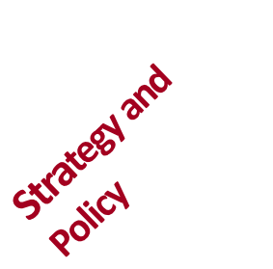
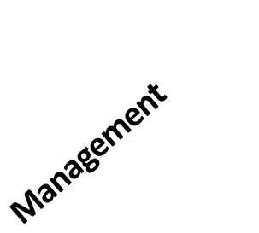
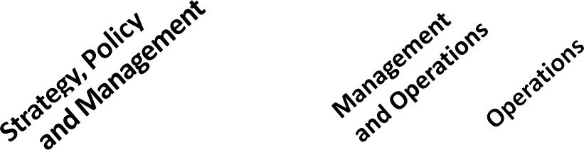
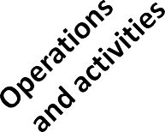

A Board Role “Continuum”
Strategy and Policy:
All board work is focused on the strategic, long-term direction of the organization, including external scanning, goal and strategy development, policy development, and overall evaluation and accountability.
Strategy, Policy, and Management:
Most board work is focused on strategy and policy, but also includes some high-level management functions.
Management:
The majority of the board's work is comprised of managing the operations of the organization, including planning, organizing, directing, supervising, and evaluating operations.
Management and Operations:
The board spends most of its time managing the operations of the organization, but also serves as the actual workforce for certain administrative or programmatic operations.
Operations and Activities:
The majority of the board's work is comprised of actually doing the frontline operational work of the organization, because board members also are the organization's volunteers.
CEO Symposium Page 42
©2026 Tecker International, LLC • www.tecker.com

Slide 43
Pre-requisites for Effective Leadership
Clarity and Consensus on What Constitutes Success
Confidence in the Competence of Your Partners
Clarity of Roles and Responsibility
Informed Decision- making; Strategic Thinking & Planning
CEO Symposium Page 43
©2026 Tecker International, LLC • www.tecker.com

Slide 44

Board Responsibilities
Set organization’s direction
Ensure necessary resources
Provide oversight
CEO Symposium Page 44
©2026 Tecker International, LLC • www.tecker.com

Slide 45

Set Organization’s Direction
Engage in strategic thinking and planning
Set the organization’s mission and vision for the future
Establish organizational values
Ensuring alignment of operational or annual plans with the strategic plan
CEO Symposium Page 45
©2026 Tecker International, LLC • www.tecker.com

Slide 46

Ensure Necessary Resources
Hire capable executive leadership
Ensure adequate financial resources
Promote positive public image
Ensure the presence of a capable and responsible Board
Ensure effective volunteer engagement
CEO Symposium Page 46
©2026 Tecker International, LLC • www.tecker.com

Slide 47

Provide Oversight
Oversee financial management
Determine acceptable risk
Measure progress on strategic plan
Monitor programs and services
Provide legal and moral oversight
Evaluate the Chief Staff Executive & Board
CEO Symposium Page 47
©2026 Tecker International, LLC • www.tecker.com

Slide 48


Oversight
Outcomes
Board
Supervision
Activity
Senior Staff
CEO Symposium Page 48
©2026 Tecker International, LLC • www.tecker.com

Slide 49
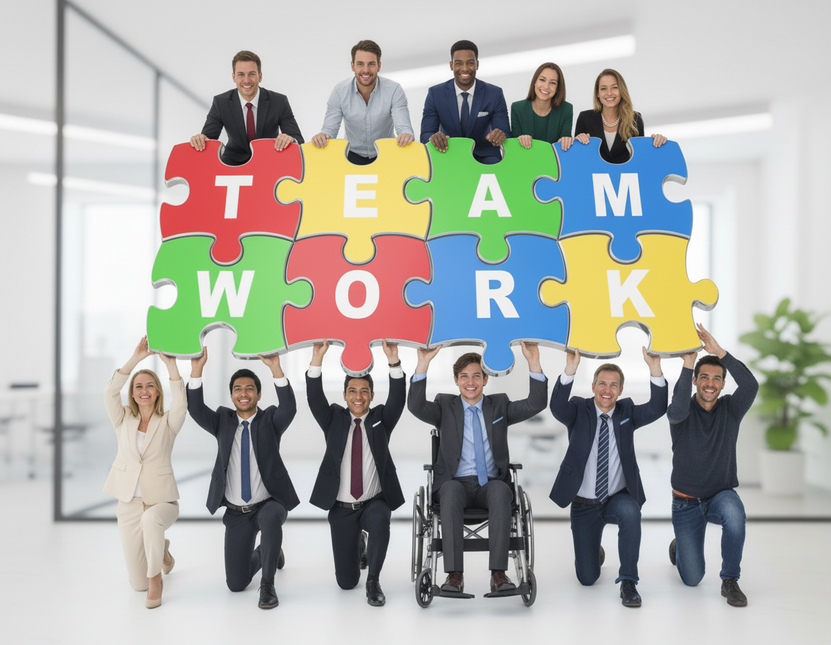
How aligned is your board with these three roles ?
Are there things that need attention?
What do you need to do to sustain alignment as board composition changes?
CEO Symposium Page 49
©2026 Tecker International, LLC • www.tecker.com

Slide 50
The Board’s Role in Budget
Define Financial Roles and Responsibilities
Ensure that the division of duties between staff, executive leadership, and the board is clearly established — including who maintains financial records, signs checks and prepares reports.
Approve the Annual Budget
Review, question, and formally approve the organization’s annual budget — including executive compensation — ensuring it aligns with the mission and strategic goals.
Establish and Oversee Financial Policies
Adopt and regularly review written policies governing financial management, reimbursements, conflicts of interest, and gift acceptance to protect the organization from compliance lapses.
Monitor Financial Performance Regularly
Require timely internal financial statements (monthly or quarterly) and ensure the board understands variances between budgeted and actual results.
Review and Understand Audited Financials
Examine the annual audited financial statements and IRS Form 990 carefully; confirm they accurately represent the organization’s condition and uphold transparency with the public.
Assess and Manage Financial Risks
Conduct an annual review of financial and operational risks, ensuring adequate insurance coverage, reserves, and internal controls are in place.
Connect Budget to Strategic Plan
Confirm that financial priorities directly support strategic goals, ensuring that resources are allocated to achieve measurable outcomes.
Ensure Regulatory Compliance
Verify that all state and federal reporting requirements are met on time and that the organization continues to fulfill its tax-exempt purpose as approved by the IRS.
Evaluate Organizational Health
Use key oversight questions to assess sustainability — e.g., “Are our income streams stable?”, “Are key expenses under control?”, “Is staff productivity strong with minimal turnover?”
Stay Informed and Engaged
Maintain an active understanding of the organization’s financial position and trends. Board members should go beyond receiving reports — they must interpret and act on them to uphold fiduciary responsibility.
CEO Symposium Page 50
©2026 Tecker International, LLC • www.tecker.com

Slide 51

Board Fiduciary Responsibilities
Duty of Care
Duty of Obedience
Duty of Loyalty
CEO Symposium Page 51
©2026 Tecker International, LLC • www.tecker.com

Slide 52
Duty of Care
Be informed and ask questions.
The duty of care describes the level of competence that is expected of a board member and is commonly expressed as the “duty of care that an ordinary prudent person would exercise in a like position and under similar circumstances.”
This means that a board member owes the duty to exercise reasonable care when he or she makes a decision as a steward of the organization.
CEO Symposium Page 52
©2026 Tecker International, LLC • www.tecker.com

Slide 53
Duty of Obedience
Requires board members to be faithful to the organization’s mission.
They are not permitted to act in a way that is inconsistent with the central goals of the organization.
A basis for this rule lies in the public trust that the organization will manage donated funds to fulfill the organization’s mission.
CEO Symposium Page 53
©2026 Tecker International, LLC • www.tecker.com

Slide 54
Duty of Loyalty
Show undivided allegiance to the organization’s welfare.
A standard of faithfulness; a board member must give undivided allegiance when making decisions affecting the organization.
A board member can never use information obtained as a member for personal gain and must act in the best interest of the organization.
Board members must comply with policies regarding code of conduct and ethical behavior.
CEO Symposium Page 54
©2026 Tecker International, LLC • www.tecker.com

Slide 55
Representative Governance
Whose interests do you represent?
The perspective you bring?
or
The association as an enterprise?
CEO Symposium Page 55
©2026 Tecker International, LLC • www.tecker.com

Slide 56
Transparency and Trust Governance
Occurs when board members understand the difference between being
“representative for” versus being “representative of.”
CEO Symposium Page 56
©2026 Tecker International, LLC • www.tecker.com

Slide 57
Representative For
If board members believe they are “representative for,” they see themselves as the elected representatives of a particular constituency.
They voice only the self interests and opinions of that constituency and vote only on behalf of that constituency’s interests.
CEO Symposium Page 57
©2026 Tecker International, LLC • www.tecker.com

Slide 58
Representative Of
Board members who view their role as ensuring that the views, beliefs, values, and self interests of the constituencies they know the best are on the table as part of the conversation, are “representative of.”
They voice interests and opinions of those they know best and vote on behalf of the best overall interests of the organization.
CEO Symposium Page 58
©2026 Tecker International, LLC • www.tecker.com

Slide 59
Board composition
is a:
process issue (selection)
dictated by structure (bylaws)
driven by culture (behavior).
Structure
Process
Culture
CEO Symposium Page 59
©2026 Tecker International, LLC • www.tecker.com

Slide 60
Balanced Board
Chapter officers, donors, and committee members are often “doers.” They don’t always make good board members for precisely the reasons they make good chapter officers, donors, and committee members.
+
Balanced Board
Competency Based Board
Constituency Based Board
=
CEO Symposium Page 60
©2026 Tecker International, LLC • www.tecker.com

Slide 61
Seven Key Attributes of Board Members
The ability to think strategically and analytically and to effectively communicate thoughts and the reasons for them.
Ability to be open and listen and hear and value all perspectives
Possession of earned respect of other key stakeholder group members
The ability to work well with others as a member of a collaborative group with group decision-making authority and an understanding of the fiduciary duties of loyalty, care, and obedience.
Demonstrated understanding of the differences between “oversight” and “supervision.”
Earned reputation for emotional maturity, personal integrity, and honesty.
A demonstrated familiarity with the body of knowledge related to both the process for which the group is responsible as well as the substantive content of the subject area within which decisions and choices will have to be made.
CEO Symposium Page 61
©2026 Tecker International, LLC • www.tecker.com

Slide 62
Vetting Candidates for a Balanced Board
Three Considerations:
Board Member Skill Sets – Key Attributes
Special Skills or Expertise Germane to Key Strategic Initiatives
Generational, Geographic, Gender, Cultural, Industry, Ethnic, or Specialty Related Experience
CEO Symposium Page 62
©2026 Tecker International, LLC • www.tecker.com

Slide 63
Achieving a Balanced Board
What are the perspectives that you want to have on the board but do not?
What needs to change in your current process to achieve the desired perspectives?
CEO Symposium Page 63
©2026 Tecker International, LLC • www.tecker.com

Slide 64
Trust
The state of readiness for unguarded interaction with someone or something
CEO Symposium Page 64
©2026 Tecker International, LLC • www.tecker.com

Slide 65
Two Different Types of Trust
PREDICTIVE TRUST:
What happens when people have known each other for a number of years.
Can predict one another’s behavior and trust how they’ll behave.
VULNERABILITY-BASED TRUST:
When people can and will be vulnerable with one another.
“I made a mistake.”
“I’m sorry. I was in a bad place.”
“You’re better at that than I am.”
Source: Patrick Lencioni
CEO Symposium Page 65
©2026 Tecker International, LLC • www.tecker.com

Slide 66

Trust = Vulnerability
Trust is when you are comfortable being open (even exposed) about your failures, weaknesses, and fears.
CEO Symposium Page 66
©2026 Tecker International, LLC • www.tecker.com

Slide 67
B
R
A
V
I
N
G
A New Way To Think About Trust
- Brene Brown
CEO Symposium Page 67
©2026 Tecker International, LLC • www.tecker.com

Slide 68
B
R
A
V
I
N
G
BOUNDARIES
Setting boundaries is making clear what’s okay and what’s not okay, and why. You’re willing to say “no.”
RELIABILITY
You do what you say you’ll do.
At work, this means staying aware of your competencies and limitations so you don’t over-promise and are able to deliver on commitments and balance competing priorities.
ACCOUNTABILITY
You own your mistakes, apologize, and make amends.
VAULT
You don’t share information or experiences that are not yours to share. I need to know that my confidences are kept, and that you’re not sharing with me any information about other people that should be confidential.
INTEGRITY
Choosing courage over comfort; choosing what’s right over what’s fun, fast, or easy; and practicing your values, not just professing them.
NONJUDGMENT
I can ask for what I need, and you can ask for what you need. We can talk about how we feel without judgment.
GENEROSITY
Extending the most generous interpretation to the intentions, words, and actions of others.
- Brene Brown
CEO Symposium Page 68
©2026 Tecker International, LLC • www.tecker.com

Slide 69

How does this apply to your partnership?
How does this apply to the board?
CEO Symposium Page 69
©2026 Tecker International, LLC • www.tecker.com

Slide 70
Leadership Agreement
Example areas where you may want to reach agreement about how the leadership partnership will:
Resolve conflict
Give each other feedback
Communicate with each other
Keep each other informed
Prepare for discussions with the Board
Other__________?
CEO Symposium Page 70
©2026 Tecker International, LLC • www.tecker.com

Slide 71
Leadership Agreement
Chief Staff Executive Promise
Be straightforward and honest in partnership
Communicate frequently and candidly
Provide the best information and resources available to the Chairman and the board
Respond promptly
Good and bad must be shared in the leadership partnership. A relationship of trust is essential.
Regular updates result in fewer questions and a better platform for addressing the board.
Access to crucial information and resources result in better decisions by the board.
Delays lead to questions. Prompt response is part of a relationship of trust.
CEO Symposium Page 71
©2026 Tecker International, LLC • www.tecker.com

Slide 72
Leadership Agreement
Chief Staff Executive Promise
I Promise to | I Promise NOT to
Example – Be truthful and honest | Example – Surprise you
Example – Respond promptly | Example - Propose a board commitment without consulting you
Example - Communicate frequently and candidly
Be straightforward and honest in partnership
Communicate frequently and candidly
Provide the best information and resources available to the Chairman and the board
Respond promptly
Good and bad must be shared in the leadership partnership. A relationship of trust is essential.
Regular updates result in fewer questions and a better platform for addressing the board.
Access to crucial information and resources result in better decisions by the board.
Delays lead to questions. Prompt response is part of a relationship of trust.
CEO Symposium Page 72
©2026 Tecker International, LLC • www.tecker.com

Slide 73
Leadership Agreement
Chief Elected Officer’s Promise
Keep board discussion focused on mission/direction/strategy
Be candid in exchange of ideas and information with the ED.
Understand the partnership and the separate roles of the Chief Elected Officer and ED.
Refer any employee situations to the ED, avoid comment or involvement
The board’s role is strategic. A focused agenda and your leadership keeps the board out of the weeds.
Honesty is essential to a strong, dynamic partnership.
Your board role is different from your regular job. Recognize the differences.
The ED works for the board. The staff work for the ED.
CEO Symposium Page 73
©2026 Tecker International, LLC • www.tecker.com

Slide 74
Leadership Agreement
Chief Elected Officer’s Promise
I Promise to | I Promise NOT to
Example - Keep board discussion focused on mission/direction/strategy | Example – Call you on the weekend
Example – Be truthful and honest | Example - Propose a board commitment without consulting you
Example – Bring operational and staff concerns to you
Keep board discussion focused on mission/direction/strategy
Be candid in exchange of ideas and information with the ED.
Understand the partnership and the separate roles of the Chief Elected Officer and ED.
Refer any employee situations to the ED, avoid comment or involvement
The board’s role is strategic. A focused agenda and your leadership keeps the board out of the weeds.
Honesty is essential to a strong, dynamic partnership.
Your board role is different from your regular job. Recognize the differences.
The ED works for the board. The staff work for the ED.
CEO Symposium Page 74
©2026 Tecker International, LLC • www.tecker.com

Slide 75

Defining Norms
…and the behaviors that will support them
Providing A Template for Discussion
CEO Symposium Page 75
©2026 Tecker International, LLC • www.tecker.com

Slide 76
Defining Norms
Norms are the bridge between principles and rules.
Norms are different from rules in that rules state exactly what must occur, when and how.
Principles are more general in that they guide people but never provide the 'how' to do it.
CEO Symposium Page 76
©2026 Tecker International, LLC • www.tecker.com

Slide 77
Responsibilities within the partnership
Board Chair (Association Volunteer Leader)
1. Preside overboard meetings – Ensure meetings are productive and focused.
2. Set agendas in partnership with the chief staff executive.
3. Facilitate board governance – Ensure effective decision-making and adherence to bylaws and policies.
4. Support and oversee the evaluation of the chief staff member.
5. Represent the board and organization externally, when appropriate.
6. Lead in strategic direction and priority setting with the board.
    Takes the lead on issues involving board members.
Chief Staff Leader (Executive Director / CEO / General Secretary)
1. Manage daily operations and staff – Ensure execution of programs, services, and initiatives.
2. Implement the board’s strategic direction and policies.
3. Serve as the primary liaison to the board – Provide information and recommendations.
4. Oversee finances and resource development.
5. Represent the organization to external stakeholders and partners.
6. Support volunteer leaders and committee work.
CEO Symposium Page 77
©2026 Tecker International, LLC • www.tecker.com

Slide 78
Examples of Areas of Behavior That Can Be Guided by Norms
Relationship Norms
Conflict-Management Norms
Decision-Making Norms
Communication Norms
Meeting Norms
Preparation Norms
CEO Symposium Page 78
©2026 Tecker International, LLC • www.tecker.com

Slide 79
Building Board Norms
Norm |  | If we see a problem we will…
1.
2.
3.
4.
5.
6.
CEO Symposium Page 79
©2026 Tecker International, LLC • www.tecker.com

Slide 80
Discussion Thread 3 – Leading the Organization
Structure
Leading volunteers
Leading decision-making
Evaluating performance
Leading through change
Process
Outcomes
Culture
CEO Symposium Page 80
©2026 Tecker International, LLC • www.tecker.com

Slide 81

How Leaders Earn Engagement From Volunteers?
Working on the things that matter to them.
Demonstrating the work is making a positive difference.
Providing an enjoyable opportunity for involvement.
CEO Symposium Page 81
©2026 Tecker International, LLC • www.tecker.com

Slide 82
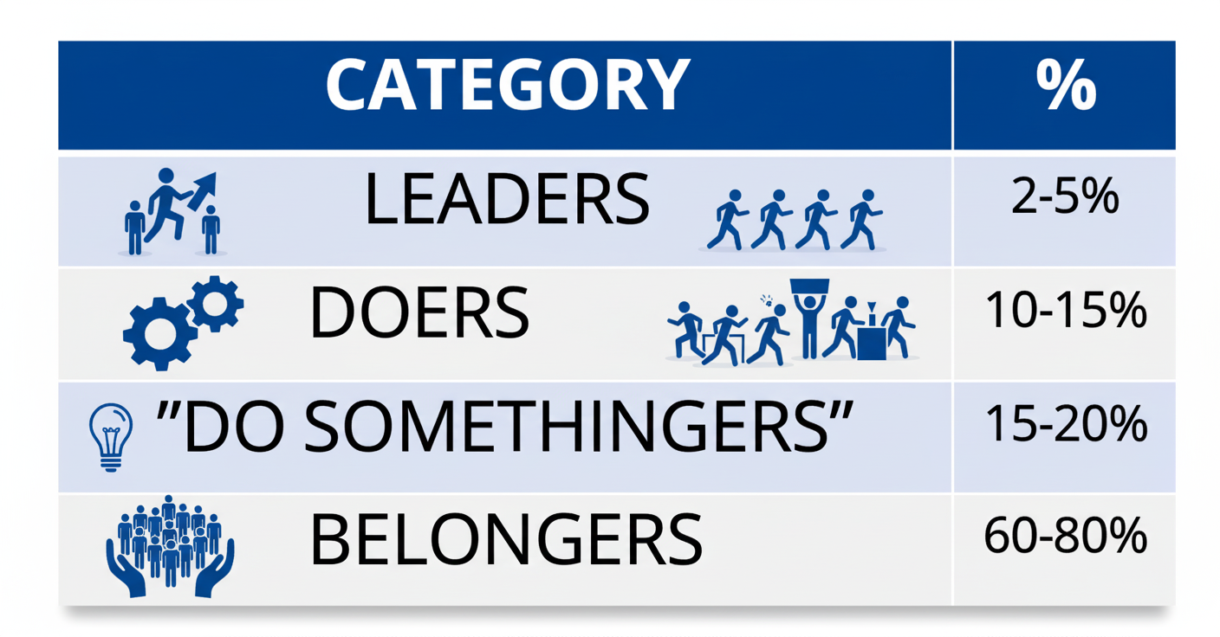
Engagement Preferences
CEO Symposium Page 82
©2026 Tecker International, LLC • www.tecker.com

Slide 83
Three Volunteer Styles
Leader – Large Scope / Long Term
Manager – Large Scope / Short Term
Task – Small Scope / Short Term and Flexible
CEO Symposium Page 83
©2026 Tecker International, LLC • www.tecker.com

Slide 84
Some Other Important Considerations In Engagement Strategy:
The member will decide their desired level of engagement.
Leader matching opportunity to desired personal rewards
Diagnose why are folks not taking an offer.
Experience, beliefs & values drive behavior
Determine & explain your allocation priority- membership development or value to current members.
Continuous influx of fresh ideas and new people.
CEO Symposium Page 84
©2026 Tecker International, LLC • www.tecker.com

Slide 85
Are our volunteers' opportunities aligned with what matters most to our members?
Are members able to participate in a way that matches their preferences?
How can we improve and/or sustain engagement to achieve our goals?
CEO Symposium Page 85
©2026 Tecker International, LLC • www.tecker.com

Slide 86
Performance ultimately is the sum of the strategic decisions you make and execute together!
CEO Symposium Page 86
©2026 Tecker International, LLC • www.tecker.com

Slide 87
Decision Making: How is Your Sight?
TYPE OF “SIGHT” (Collectively they equal Informed Intuition) | WHAT YOU NEED TO PLAN FOR THE FUTURE
Hindsight - understanding of a situation or event only after it has happened or developed.. | Understanding how you got to present state. (Churchill: “Those who fail to learn from history are condemned to repeat it.”) Evaluation of programs and services Measurable objectives
Foresight - the ability to predict what will happen or be needed in the future. | Innovation and new product/program development process Staying true to core purpose and core values, mission and vision Honest evaluation of capacity and strategic position
Insight - the capacity to gain an accurate and deep intuitive understanding of a person or thing. | Decision-focused research integrating strategic thinking and planning Identifying leverage points to shape culture to stay relevant in changing times
Informed Intuition
CEO Symposium Page 87
©2026 Tecker International, LLC • www.tecker.com

Slide 88
Flaws in Decision Making
(Adapted from “Hidden Flaws in Strategy” by Charles Roxburgh, 2003)
Overconfidence – the tendency to want to do more than is possible.
“Mental Accounting” – the tendency to misunderstand how the sources of revenue relate to how money is spent.
 | Like us |  | Not like us
Status Quo Bias – the tendency to want to leave things as they are.
Anchoring – the tendency to choose what is familiar.
Sunk-Cost Effect – the tendency to keep investing in bad strategies/activities.
Herding Instinct – the tendency to conform to the behavior and opinion of others.
False Consensus – the tendency to overestimate group consensus and desire to agree with others.
CEO Symposium Page 88
©2026 Tecker International, LLC • www.tecker.com

Slide 89
Realization of Full Potential
Driving Factors (+)
Restraining Factors (-)
Current State
Barriers
CEO Symposium Page 89
©2026 Tecker International, LLC • www.tecker.com

Slide 90
Dialogue vs Deliberation
Why is it important to do this?
The importance of asking the right question…
CEO Symposium Page 90
©2026 Tecker International, LLC • www.tecker.com

Slide 91
A Framework for Dialogue and Deliberation
Dialogue to inform the issue
Dialogue to identify and evaluate strategic choices
Deliberation to determine consensus and reach a decision
Craft a motion, deliberate and vote
CEO Symposium Page 91
©2026 Tecker International, LLC • www.tecker.com

Slide 92
Four Knowledge Bases
What do we know about our stakeholders’ needs, wants, and preferences that are relevant to this decision?*
What do we know about the current realities and evolving dynamics of our environment that is relevant to this decision?*
What do we know about the “capacity” and “strategic position” of our organization that is relevant to this decision?*
What are the ethical implications?
*What do we wish we knew, but don’t?
CEO Symposium Page 92
©2026 Tecker International, LLC • www.tecker.com

Slide 93
Question 1: Needs, Wants, & Preferences
Key Stakeholder | Needs, Wants & Preferences
CEO Symposium Page 93
©2026 Tecker International, LLC • www.tecker.com

Slide 94
Four Knowledge Bases
What do we know about our stakeholders’ needs, wants, and preferences that are relevant to this decision?*
What do we know about the current realities and evolving dynamics of our environment that is relevant to this decision?*
What do we know about the “capacity” and “strategic position” of our organization that is relevant to this decision?*
What are the ethical implications?
*What do we wish we knew, but don’t?
CEO Symposium Page 94
©2026 Tecker International, LLC • www.tecker.com

Slide 95
Question 2: Current Realities and Evolving Dynamics
Current Conditions | Trends | Assumptions About the Future
What’s going on now? | A change in progress and the direction of the change | Something that could happen in the foreseeable future that would make a big difference
CEO Symposium Page 95
©2026 Tecker International, LLC • www.tecker.com

Slide 96
Four Knowledge Bases
What do we know about our stakeholders’ needs, wants, and preferences that are relevant to this decision?*
What do we know about the current realities and evolving dynamics of our environment that is relevant to this decision?*
What do we know about the “capacity” and “strategic position” of our organization that is relevant to this decision?*
What are the ethical implications?
*What do we wish we knew, but don’t?
CEO Symposium Page 96
©2026 Tecker International, LLC • www.tecker.com

Slide 97
Question 3: Capacity & Strategic Position
STRATEGIC POSITION: factors in the external environment including competitors and dynamics the organizations cannot control
CAPACITY:
tangible and intangible assets of the organization
CEO Symposium Page 97
©2026 Tecker International, LLC • www.tecker.com

Slide 98
Capacity & Strategic Position
Capacity |  | Strategic Position
Strengths | Weaknesses | Strengths | Weaknesses
CEO Symposium Page 98
©2026 Tecker International, LLC • www.tecker.com
Notes:
98

Slide 99
Four Knowledge Bases
What do we know about our stakeholders’ needs, wants, and preferences that are relevant to this decision?*
What do we know about the current realities and evolving dynamics of our environment that is relevant to this decision?*
What do we know about the “capacity” and “strategic position” of our organization that is relevant to this decision?*
What are the ethical implications?
*What do we wish we knew, but don’t?
CEO Symposium Page 99
©2026 Tecker International, LLC • www.tecker.com

Slide 100
Question 4: What are the ethical implications?
Example Considerations
Related to the public good
Advantages and disadvantages to certain groups
Consistent with core values
Other____________________?
_________________________________________________________________________________________________________________________________________________________________________________________________________________________________________________________________________________________________________________________________________________________________________________________________________________________________________
CEO Symposium Page 100
©2026 Tecker International, LLC • www.tecker.com

Slide 101
Mega Issue
The mega-issue question
What do we know about needs and preferences? | What do we know about current realities and evolving dynamics? | What do we know about capacity and strategic position? | What do we know about ethical implications?
CEO Symposium Page 101
©2026 Tecker International, LLC • www.tecker.com

Slide 102
Choice
Choice: A discrete, but not necessarily
mutually exclusive, alternative
Do nothing
Do something
What are the possible “some-things”?
CEO Symposium Page 102
©2026 Tecker International, LLC • www.tecker.com

Slide 103
Our Choices
Choice: a discrete, but not necessarily exclusive, alternative
Choice: |  | Choice: |  | Choice: |  | Choice:
Advantages | Disadvantages | Advantages | Disadvantages | Advantages | Disadvantages | Advantages | Disadvantages
CEO Symposium Page 103
©2026 Tecker International, LLC • www.tecker.com

Slide 104
Determining Areas of Consensus
Are there any choices we want to eliminate?
What choices are we prepared to commit to now?
Are there any choices that can be combined with others?
Are there choices we are still interested in but need more information about before deciding?
CEO Symposium Page 104
©2026 Tecker International, LLC • www.tecker.com

Slide 105

Deliberate on the Motion
Develop the motion as committee of the whole (or during a recess)
In parliamentary procedure, adjourn the committee of the whole and return to board process.
Return to normal deliberative process.
CEO Symposium Page 105
©2026 Tecker International, LLC • www.tecker.com

Slide 106

Delegation by the Board
Rule 1: Only Do What Only You Can Do
Rule 2: Be Clear About Expected Outcomes
Rule 3: Understand How You Will Monitor Progress Without Meddling
CEO Symposium Page 106
©2026 Tecker International, LLC • www.tecker.com

Slide 107


NINE CHARACTERISTICS OF A GOOD BOARD SELF-EVALUATION PROGRAM
By Leigh Wintz, FASAE, CAE, Principal Consultant, Tecker International, LLC
CEO Symposium Page 107
©2026 Tecker International, LLC • www.tecker.com

Slide 108
Board Self Evaluation
The association leadership experience is a group experience and a group responsibility. This group experience is most successful when expectations are clearly defined and agreed to by all parties. One way a board can promote clarity of purpose is by engaging in self-evaluation.
The purpose of this survey is to focus on key responsibilities, relationships, and outcomes – and to foster an environment of organizational excellence. Only a commitment on the part of board and staff members to strengthen the capacity for group excellence can overcome the complex challenges facing many associations today.
Please take a few moments to read the following statements. How accurately do they describe your board? Answer on a scale of one to six, with one being “not at all like us” and six being “very much like us.”
CEO Symposium Page 108
©2026 Tecker International, LLC • www.tecker.com

Slide 109
Oversight and Direction Setting
Very much Not at all like us like us |  |  |  |  |  | Attribute
6 | 5 | 4 | 3 | 2 | 1 | We participate in board meetings where the majority of the agenda and board time is focused on issues of direction setting, policy and strategy.
6 | 5 | 4 | 3 | 2 | 1 | We maintain sound fiscal policy and practices and realistically face the financial ability of the organization to support its program of work.
6 | 5 | 4 | 3 | 2 | 1 | We are committed to strategically planning for the long-term future of the organization, consider this a regular activity of the board, and weigh all decisions in terms of what is best for those served by the organization.
6 | 5 | 4 | 3 | 2 | 1 | We work to foster growth in the organization based on the ability to understand how the decision(s) interrelate with other Boards, committees, and external organizations.
6 | 5 | 4 | 3 | 2 | 1 | We take into consideration the immediate and long-term issues and ramifications associated with the decisions and actions that are taken.
CEO Symposium Page 109
©2026 Tecker International, LLC • www.tecker.com

Slide 110
Relationship with Chief Staff Officer
Very much Not at all like us like us |  |  |  |  |  | Attribute
6 | 5 | 4 | 3 | 2 | 1 | We have clarified (in writing, if appropriate) a mutually agreed upon definition of what success will look like for the organization and for the performance of the CSO, and we have provided the resources and authority necessary to achieve expectations.
6 | 5 | 4 | 3 | 2 | 1 | We have provided the CSO with a clear statement of the personal qualities and performance expectations against which he/she will be measured periodically; and we have agreed to a formative process for providing feedback as plans are being executed.
6 | 5 | 4 | 3 | 2 | 1 | We provide opportunities, encouragement and resources for the professional growth and development of the CSO and staff.
6 | 5 | 4 | 3 | 2 | 1 | We discuss immediately, rather than allow to fester or deteriorate, those items that are controversial to either board members or the CSO.
CEO Symposium Page 110
©2026 Tecker International, LLC • www.tecker.com

Slide 111
Interpretation
Very much Not at all like us like us |  |  |  |  |  | Implication
xxxx | xxxx |  |  |  |  | Consensus: A strength to be recognized and nurtured
 |  |  |  | xxx | xxxx | Consensus: A weakness to be examined and corrected
x | xx | x | x | xx | x | Distributed response: A bad item / Different understandings / Different experiences as a member of the board. A response to be diagnosed and cause corrected.
xxxx |  |  |  |  | xxxx | Bifurcated response: Widely divergent understandings / A secondary, symbolic, or symptomatic item reflecting a values dispute. A response to be diagnosed and the root cause examined and resolved.
xxxx | xxx |  |  |  | x | An outlying response: Different understanding / different experience elsewhere. A response to be understood and considered for potential to improve process.
Note: Means, medians and modes can be useful but are usually insufficient*
CEO Symposium Page 111
©2026 Tecker International, LLC • www.tecker.com

Slide 112
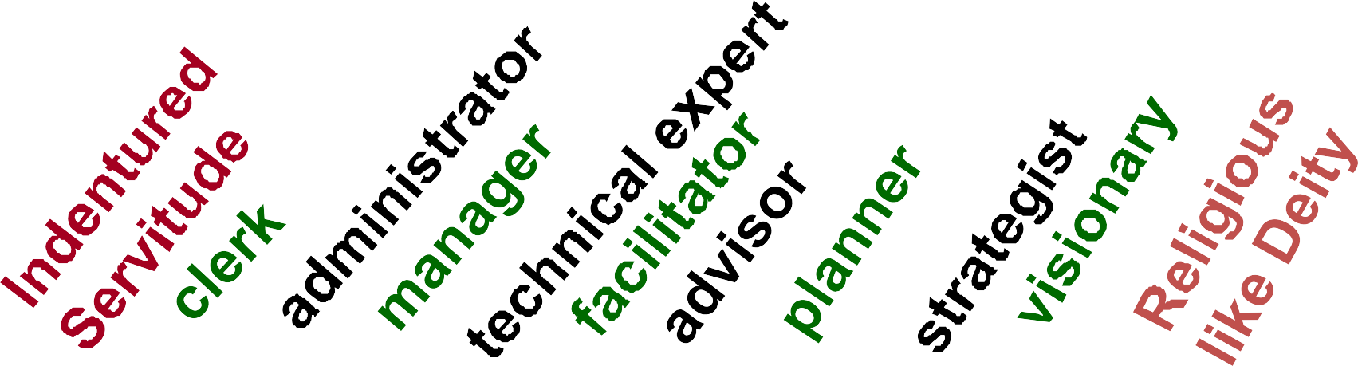
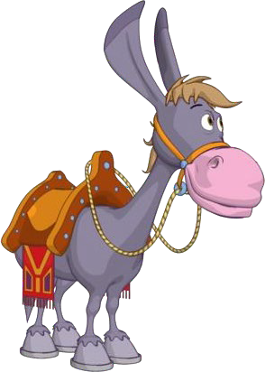
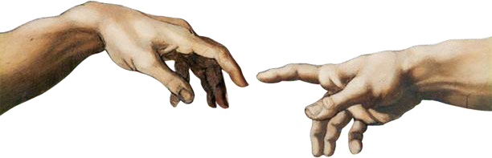
A Role “Continuum” for the Chief Staff Executive
CEO Symposium Page 112
©2026 Tecker International, LLC • www.tecker.com

Slide 113


CHARACTERISTICS OF A GOOD CEO EVALUATION PROGRAM
By Glenn Tecker, Chairman and CO-CEO, Tecker International, LLC
CEO Symposium Page 113
©2026 Tecker International, LLC • www.tecker.com

Slide 114

Find a process that suits both the
Chief Staff Executive and the Association
Key Considerations:
Is the CSE perceived as a leader or a manager?
How are your members evaluated in their workplace?
CEO Symposium Page 114
©2026 Tecker International, LLC • www.tecker.com

Slide 115
Leadership imperative
Maintain Identity
Maintain Direction
Evaluate Strategy
Reassess Priorities
Deliver Value
Always and especially during times of crisis or uncertainty.
CEO Symposium Page 115
©2026 Tecker International, LLC • www.tecker.com

Slide 116
Challenges facing Associations In Times of Significant Uncertainty
Dealing with immediate challenges while continuing to build for the future.
Responding to the unique dynamics of our members’ changing environments - “one size does not fit all”.
Leaders looking for the “fix” or response that is closest to their needs while the organization needs to maintain a longer-term focus.
Finding the right balance between reinvention and the predictable.
Looking out for the well-being of members and staff.
Maintaining member ownership and accountability while relying on staff for greater decision-making.
CEO Symposium Page 116
©2026 Tecker International, LLC • www.tecker.com

Slide 117
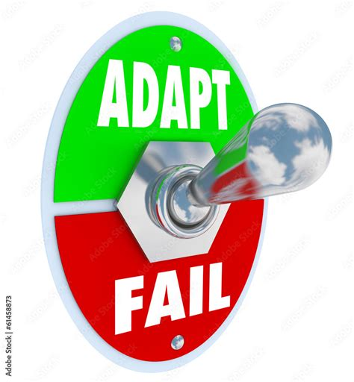
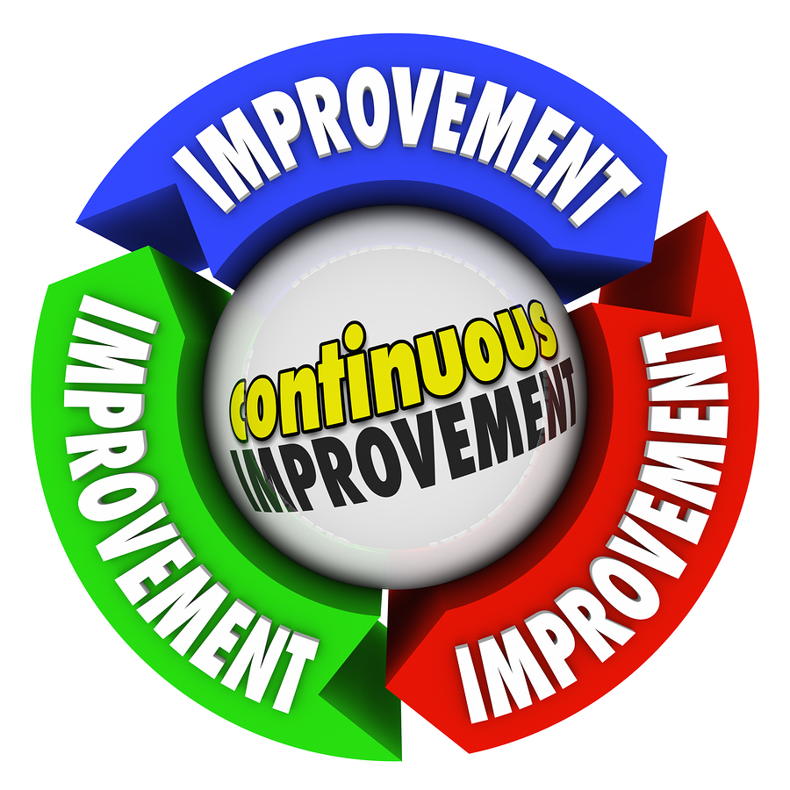


Building and Maintaining a Culture of Innovation
is essential to the future success of any organization. It allows us to. . .
Adapt to Change: Member expectations, industry landscapes, and societal
trends evolve constantly. Innovation ensures that an organization remains nimble and
capable of meeting these changes head-on.
Sustain Impact: An organization that clings to outdated methods risks becoming
irrelevant. Innovation ensures programs, services, and strategies remain aligned with current and future needs.
Continuously Improve: No process, event, or program is perfect. Embracing
innovation means viewing every initiative as a stepping-stone, with opportunities to
refine, enhance, and amplify impact based on lessons learned.
Enhance Value: Members expect more than static services. Organizations that
innovate provide new, dynamic ways to deliver value, creating deeper engagement and
loyalty. They expect programs and services that deliver impact for their profession or
industry.
CEO Symposium Page 117
©2026 Tecker International, LLC • www.tecker.com

Slide 118
Planning Strategically
Thinking Strategically
Thinking Strategically is the foundation of all activities and actions.
An Ongoing Process for Continuous Improvement to Deliver Impact
Acting Strategically
Acting strategically putts the plan into motion and ensuring the organization follows through with its commitments.
This process translates strategic thinking into a clear, prioritized, actionable plan.
CEO Symposium Page 118
©2026 Tecker International, LLC • www.tecker.com
Notes:
To deliver impact in a dynamic environment, organizations must master the interrelated processes of thinking, planning, and acting strategically. This integrated approach ensures alignment with the core purpose, adaptability to change, and the capacity to create lasting value.

Slide 119
A Unified Approach to Strategy
Integrating thinking, planning, and acting strategically builds a resilient, focused, and impactful organization.
Aligns foresight, preparation, and execution
Enhances responsiveness to dynamic environments
Strengthens leadership, governance, and value creation
Establishes a common understanding of success – our GPS coordinate
CEO Symposium Page 119
©2026 Tecker International, LLC • www.tecker.com

Slide 120
Thinking Strategically
Strategic thinking balances foresight, insight, and adaptability for long-term success.
Anticipatory Vision
Curiosity-Driven Insight
Adaptive Resilience
Understanding Patterns
Holistic Perspective
Guiding Questions:
What are the most significant drivers of change impacting the profession or industry we serve?
Where do we aim to be in ten years?
What emerging risks and opportunities must we anticipate?
CEO Symposium Page 120
©2026 Tecker International, LLC • www.tecker.com

Slide 121
Acting Strategically
Turning plans into outcomes through disciplined execution and evaluation.
Ensure Resource Alignment (annual business plan and budget)
Provide Clear Charges For Volunteer Workforce
Monitor Progress and Adapt
Accountability and Agility
Leverage Insights from Implementation
Refine Structures and Processes
CEO Symposium Page 121
©2026 Tecker International, LLC • www.tecker.com

Slide 122

Sustaining Relevance - Strategy as a GPS
It’s a marathon not a sprint!
Associations are designed to pursue high level value that requires consistent organized attention over time.
Special challenges for associations: The route keeps changing and there is NO finish line.
CEO Symposium Page 122
©2026 Tecker International, LLC • www.tecker.com

Slide 123

Sustaining Relevance - Strategy as a GPS
Balancing the aspirational (envisioned future and goals) and the actionable (meeting today’s needs)
Pursuing a compelling vision of the future while providing relevant value today consistent with that vison
CEO Symposium Page 123
©2026 Tecker International, LLC • www.tecker.com

Slide 124
Associations too often tell members about features instead of focusing on the benefits they should receive.
Features
Outputs (The things we do)
Benefits
Outcomes (What members are looking for)
Actionable Knowledge – Helps members make better professional or business decisions
Insight into Change – Understand trends and anticipate what’s next
Credibility & Community – Connects professionals within a trusted network
Advocacy – Representing member interests in policy and regulation
Events – Conferences, webinars, and networking opportunities
Publications – Trusted, curated information and research
Standards – Industry benchmarks, best practices, certifications

Slide 125
Strategic Plan Framework
Essential Elements of an Effective Strategic Plan Framework
CEO Symposium Page 125
©2026 Tecker International, LLC • www.tecker.com

Slide 126
Core Purpose & Core Values
Defines why the organization exists and the principles that guide behavior, culture, and decision-making.
Vision of Future Success
Describes the long-term aspiration and vivid narrative of what success looks like.
CEO Symposium Page 126
©2026 Tecker International, LLC • www.tecker.com

Slide 127
5-Year Goals
Outcome-oriented targets serving as milestones toward the vision.
2–5 Year Strategic Objectives
Focused areas for meaningful change to achieve goals.
1–2 Year Tactics
Specific initiatives and program alignments supporting the objectives.
CEO Symposium Page 127
©2026 Tecker International, LLC • www.tecker.com

Slide 128
KPIs / Metrics
Quantitative and qualitative indicators to assess progress.
Budget & Volunteer Structure
Aligns financial and human resources to enable effective implementation.
Annual Operating Plan
Year-by-year roadmap translating strategy into action.
CEO Symposium Page 128
©2026 Tecker International, LLC • www.tecker.com

Slide 129
Basic Types of Measures
Input measures – how much is coming in - number of dollars, number members, number of donors, number of renewals etc.
Output measures- how much is going out- number of programs, number of publications, number of visits to policymakers, etc.
Outcome measures- the value provided – did knowledge increase, was the regulation amended, did the publication allow members to prepare, etc.
CEO Symposium Page 129
©2026 Tecker International, LLC • www.tecker.com

Slide 130
Planning Strategically Checklist
Check the box that best describes your association. | A Strength | Room for Improvement | Don’t have
Environmental “Scan” – an annual review of external conditions that could impact future planning
Core Purpose – is relevant, clear and responsive to our environment
Core Values – are a set of core behaviors necessary to fulfill our purpose
Envisioned Future (Vision/Big Audacious Goal and Vivid Description) – reflects a longer-term unrealized goal and vivid description driving shorter-term planning
CEO Symposium Page 130
©2026 Tecker International, LLC • www.tecker.com

Slide 131
Planning Strategically Checklist
Check the box that best describes your association. | A Strength | Room for Improvement | Don’t have
Goals – are stated outcomes to be achieved in a shorter-term (3-5 years) planning horizon.
Objectives – are direction setting statements within each goal area.
Prioritization of Objectives and Activities – a process for leadership to identify shorter-term priorities within the longer-term plan.
Schedule for Plan Review – a commitment to following a schedule of ongoing strategic plan review and assessment.
CEO Symposium Page 131
©2026 Tecker International, LLC • www.tecker.com

Slide 132
Strategy vs. Operational Planning
Strategic Planning
Operational Planning
Longer-term
Driven by the vision
Responsive to external environment
Alignment of programs and services
Establishes direction
Leadership is accountable
Annual planning
Driven by the strategic plan and ongoing operations
Improvements on existing programs and services
Establishes work priorities
Staff and volunteer work groups are accountable
Budget
CEO Symposium Page 132
©2026 Tecker International, LLC • www.tecker.com

Slide 133
Budget Oversight - Asking The Right Questions
Is the budget development process clear to all staff and leadership? (Example: zero based or “copy and paste”)
What has changed since the budget was developed?
Have we considered what might happen this coming year? In the next three years?
Does this budget advance the association toward its goals and objectives?
CEO Symposium Page 133
©2026 Tecker International, LLC • www.tecker.com

Slide 134

Resistance to Change
What will it be like?
Increase comfort
Create a vision
Support Neutrality
Unknown
Change
Resistance
Anxiety
Fear
Opposition
Unknown
Will I be able to handle it?
Increase self esteem
Demonstrate confidence in their competence
CEO Symposium Page 134
©2026 Tecker International, LLC • www.tecker.com

Slide 135
Based on robust analysis of 500,000+ surveys
in 152 languages, here are the 56 values that drive all human behavior.
Family
Relationships
Financial Security
Belonging
Community
Personal Growth
Loyalty
Religion/Spirituality
Employment Security
Personal Responsibility
Basic Needs
Harmony
Health/Well-Being
Experiences
Respect
Compassion
Social Standing
Creativity & Imagination
Trustworthiness/Honesty
Security
Education
Tradition
Balance
Love
Material Possessions
Patience
Morality
Righteousness
Friendships
Authority
Positive Environments
Happiness
Ambition
Self-Control
Self-Expression
Environmentalism
Independence
Wealth
Politeness
Generosity
Equality 51. Peace
Service to Others 52. Money
Dependability 53. Unselfishness
Courage 54. Confidence
Cooperation 55. Freedom of Speech
Tolerance 56. Determination
Leisure
Influence
Intimacy
Political Freedom
CEO Symposium Page 135
©2026 Tecker International, LLC • www.tecker.com

Slide 136
Nature of Change and Transition
Change
Transition
An event
  Either anticipated or unanticipated
  Either chosen or imposed from somewhere else
Change is external
A personal reaction
– How we alter behavior and perspective to come to terms with the change
Transition is internal
CEO Symposium Page 136
©2026 Tecker International, LLC • www.tecker.com

Slide 137
The Transition Process*
Endings
→ Chaos → New Beginnings (Wait) (Start)
(Stop)
The starting point for transition is not the change.
ENDINGS are required to leave the old behind.
*William Bridges, Managing Transitions: Making the Most of Change
CEO Symposium Page 137
©2026 Tecker International, LLC • www.tecker.com

Slide 138
Key Leadership Issue:
Keeping the Board Focused On:
Purpose not just mission –
monitor impact not just activity
Sustaining value – treat strategy as a GPS rather than a roadmap
Continuously adapt and move forward – don’t just "pivot" or declare a "transformation”
CEO Symposium Page 138
©2026 Tecker International, LLC • www.tecker.com

Slide 139
So…
What will we do differently as a result of the conversations over the last two days?
What will we direct/assist others to do differently as a result of these conversations?
CEO Symposium Page 139
©2026 Tecker International, LLC • www.tecker.com

Slide 140
Glenn Tecker
Glenn Tecker is Chairman and Co-CEO of Tecker International, LLC, a multinational consulting practice that has completed projects for over 2000 groups in the U.S., Europe, Canada, Asia, Scandinavia, Mexico, and Central America.
Glenn is widely acknowledged as one of the world’s foremost experts on leadership and strategy. Having worked in an executive capacity with businesses, public agencies, and non-profit organizations, he has also served as a board member for a number of non-profit and for-profit organizations. Glenn’s particular expertise in the areas of governance, program strategy, organizational design, research analysis and presentation skills will be critical to the effort. Some highlights of his accomplishments include:
Guiding National Collegiate Athletic Association [NCAA] member and staff leadership of the through a participative and transparent process that redefined the organization's core purpose and values, developed vision-based strategy and action plans, and realigned the NCAA's priorities to lead a re-focusing of the university athletic experience for the 21st Century.
Developing new organizational, program, and operational strategy with the United States Green Building Council [USGBC] to provide innovative solutions to global ecological concerns in order to successfully navigate a period of multiple opportunities, complex demands and rapid growth. Designing and conducting an institute for an international philanthropic organization to train representatives from 10 Asian nations with a tradition of conflict.
Devising strategy and developing competencies with school districts, educational agencies, and school board and teacher associations working to improve teaching, learning, and organization.
Assisting the United States Environmental Protection Agency, the American Water Works Association, the Technical Institute of the Pulp and Paper Industry and other environmental advocacy organizations to foster global use of technologies that contribute to quality of life.
Facilitating planning activities of information, telecommunications and entertainment related organizations in high technology industries challenged by tough competition and constant dramatic change.
Supporting research and program planning efforts of agricultural organizations addressing complex issues related to food safety, industry prosperity, and shifts in the demography and economics of agriculture.
•
•
•
•
•
•
Glenn is also the co-author of three best-selling books – The Will to Govern Well: Knowledge, Trust and Nimbleness; Building a Knowledge-Based Culture: Using 21st Century Work and Decision-Making Systems in Associations; and Successful Association Leadership: Dimensions of 21st Century Competency for the CEO. he previously also served as Board Chair of New Hope Academy – a nonprofit multi-campus nontraditional alternative school in Pa. Glenn currently serves as vice chair of the national the Board of Guide Dogs for the Blind Foundation and America’s Vet Dogs in NY. In 1998, Glenn was honored as the recipient of ASAE’s Academy of Leaders Award - the highest possible recognition awarded by ASAE’s Board of Directors to individuals who have made a lasting contribution to the field of association management.
CEO Symposium Page 140
©2026 Tecker International, LLC • www.tecker.com

Slide 141
Jim Meffert
Jim Meffert brings 25 years of experience to the Tecker team. Dubbed the “organizational psychologist” by some of his clients, Jim focuses on the dynamics among stakeholders by facilitating conversation and listening carefully for underlying motivations. Understanding how to get people to a place of unified action, motivated to support a direction and create impact is the skill that drove Meffert to run for Congress
Throughout his career, Jim has been a catalyst for growth, redesign, and positive change. Jim has worked with leaders in the public, private, and non-profit sectors and is most skilled at building the bridges between them. He has helped national organizations move beyond their differences and overcome paralysis by helping them see mutual and connected interests. He has rebuilt deeply troubled organizations and created national brand strategy and advocacy frameworks. Jim has served as Executive Director of the Minnesota Optometric Association, the Jefferson Center and Jefferson Action. His experience also includes working with national medical specialty societies in the Office of Federation Relations at the American Medical Association. Prior to that, he was in charge of federal and state government and chapter relations for the American Society of Plastic Surgeons.
Professional Snapshot:
More than 25 years in association and nonprofit management; 14 as Executive Director
Extensive experience with strategic planning, organizational design, leadership training, executive management, leadership transition, advocacy project development and branding.
Experience working with medical specialty societies, professional health care provider associations, education associations and coalitions, education institutions and foundations, and corporations.
Expertise in advocacy campaigns and working with state and federal political action committees
Alumnus of ASAE Future Leaders Program
Bachelor of Arts, Political Science, St. Olaf College
CEO Symposium Page 141
©2026 Tecker International, LLC • www.tecker.com

Slide 142
Gregory J. Fine, FASAE, CAE
With more than 30 years of successfully helping organizations grow and prosper; combined with boundless energy, passion and enthusiasm, Greg's collaborative approach delivers the insight, strategies, and resources necessary to turn intent into action. Prior to joining Tecker International, he served as executive vice president and CEO of CCIM Institute, a 13,000-member international professional association. Before that, he was global CEO of the Turnaround Management Association. With a reputation for organizational change and innovation, his diverse and successful career has provided him with deep and comprehensive expertise that informs all of his work.
Greg is a respected and engaged volunteer leader. He serves on the faculty for ASAE CEO Symposium and the U. S. Chamber of Commerce Institute for Organization Management. He was a member of the ASAE and ASAE Foundation Boards, Association Media & Publishing Board - including tenure as president, the DigitalNow Advisory Group, and the Chamber’s Association Committee of 100. Greg was named the 2017 Association Forum Inspiring Leader and he was recognized as one of Crain’s Chicago 2020 Notable LGBTQ Executives. He is prolific writer and speaker, most recently co-authoring a chapter in Professional Practices in Association Management (4th edition 2021
Growing up in Missoula, Montana, Greg was a leader from his earliest years. This included becoming one of the state's youngest elected officials in history when, at age 18, he was elected to the Missoula County High Schools Board of Trustees. He was re-elected twice and served as Board Chair. He is a graduate of The University of Montana with a BA in PSc and History Minor, is an avid world traveler, and an award-winning amateur poet. A digital nomad, Greg’s current basecamp is in Scottsdale, AZ.
CEO Symposium Page 142
©2026 Tecker International, LLC • www.tecker.com

Slide 143
Cheryl Williams
Cheryl Williams is a Senior Consultant with Tecker International, where she brings more than two decades of Fortune 50, corporate, global nonprofit, and consulting experience to her work with mission-driven organizations. Cheryl is known for her ability to help clients thrive through best-in-class coaching, capacity building, and strategic communications. Her career has been dedicated to helping organizations plan, develop, and communicate effectively to increase their visibility, impact, and long-term success.
Before joining Tecker International, Cheryl spent 22 years with Procter & Gamble, where she led brand visibility and reputation management for domestic and international brands representing over $30 billion in annual retail sales. Her responsibilities spanned three continents, including an in-country assignment in Singapore where she developed and executed a regional external relations plan that revitalized a global luxury skincare brand across Asia. Her work has included collaborations with Academy Award–winning and –nominated talent such as Queen Latifah and Cate Blanchett, as well as leading public relations for P&G’s first beauty and grooming salon at the 2010 Winter Olympics.
Cheryl’s professional achievements extend beyond the corporate sphere into meaningful nonprofit service. She has held leadership and board roles in a variety of faith-based and community organizations, advancing humanitarian initiatives in more than a dozen countries including Uganda, Nicaragua, and India. Locally, she has served on the boards of Baltimore Center Stage, the Baltimore Design School, the Baltimore School for the Arts, and United Lutheran Seminary. Her work in these spaces reflects her enduring commitment to purpose-driven leadership and community impact.
A certified executive coach credentialed by the International Coach Federation, Cheryl holds the Advanced Certified Personal and Executive Coach certification from the College of Executive Coaching. She earned a B.S. in Computer Science from North Carolina State University, and both an M.S. in Business and an M.B.A. from The Johns Hopkins University. A native New Yorker who proudly calls Baltimore home, Cheryl continues to be an advocate for leadership excellence, organizational effectiveness, and the transformative power of strategic communication.
CEO Symposium Page 143
©2026 Tecker International, LLC • www.tecker.com

Slide 144
About Tecker International, LLC
For more than 30 years, Tecker International (LLC) has helped thousands of clients meet goals, impact lives and change the world. TI is a client-focused, mission-driven international consulting practice offering a broad range of services tailored to fit our clients’ unique needs. In partnership with our clients, we identify opportunities, overcome challenges and create structures and processes nimble enough to adapt to environments of rapid change. Our knowledge-based, outcomes-oriented approach has helped to transform associations, not-for-profit organizations, institutions and businesses of all kinds.
The collective competencies of the Tecker team enable us to provide the talent, skills and expertise to achieve the goals of each of our clients. Drawing on the firm’s knowledge base and experiential resources, we employ a friendly, collaborative approach to empower organizations to succeed. In additional to being expert strategists, skillful facilitators and subject-matter experts, Tecker consultants are also top-notch educators who are always willing to share fresh ideas and proven methods of success. When you engage with Tecker, you choose a team of friendly, responsive, respected professionals, with extensive knowledge of personal and organizational dynamics. Their passion and enthusiasm inspires and motivates leaders to take action and tackle challenges head on.
TI specializes in managing change, strategic planning, governance remodeling, repositioning companies and programs, strategic alliances and consolidations, market and member research, executive coaching, parliamentary procedure and a variety of other disciplines. We offer in-depth subject matter knowledge of specific industries, businesses and professions. TI builds a sustaining culture of innovation to support an organization’s ability not only to survive but to thrive. Our clients return to us again and again because they experience the measurable, positive outcomes our knowledge-based strategic thinking and planning creates. We guide volunteer and staff leaders to lead with confidence and clarity.
With so many consultants to choose from, what factors set the Tecker team apart?
We are committed to superior thinking achieved by a team that is constantly learning and sharing through client engagements, original research, full community participation and by serving as faculty for the ASAE CEO Symposium.
We listen to our clients and their needs are our first priority.
For each engagement, we build a shared vision of the future based on knowledge, not opinion.
We provide practical tools to achieve the shared vision of the future.
We ensure implementation by including all key stakeholders in building and supporting change.
We understand that there are no best practices, only good practices customized to the unique needs and cultures of each of our clients.
We develop successful volunteer/staff teams based on their unique roles and their importance to the success of the organization.
We help staff create plans for communication, action and evaluation to ensure successful follow through on decisions made.
We have a genuine love of what we do and a deep appreciation of the value diverse perspectives bring to analytic and creative discussions.
CEO Symposium Page 144
©2026 Tecker International, LLC • www.tecker.com

